Slide 1
PZ10CX - LISP
Programming Language Design and Implementation (4th Edition)
by T. Pratt and M. Zelkowitz
Prentice Hall, 2001
Section 10.4.1
Appendix A.6

Slide 2
LISP overview
LISP was first designed and implemented by John McCarthy at MIT around 1960
LISP widely used for artificial intelligence research
First language based on applicative execution
LISP has equivalence of form between programs and data, which allows data structures to be executed as programs and programs to be modified as data
In the late 1970s, Gerald Sussman and Guy Steele developed a variant named Scheme. This is the version that had the most impact on university use of LISP.
In 1992 a standard for Common LISP was finally written

Slide 3
LISP features
LISP functions are defined entirely as expressions.
Data in LISP are rather restricted. Literal atoms and numeric atoms (numbers) are the basic elementary types.
LISP provides a wide variety of primitives for the creation, destruction, and modification of lists (including property lists). Basic primitives for arithmetic are provided.
LISP control structures are relatively simple. The expressions used to construct programs are written in strict Cambridge Polish form and may include conditional branching.
Function parameters are transmitted either all by value or all by name depending on the classification of the function.
Execution heavily dependent on heap storage

Slide 4
LISP (scheme) example
1 %lisp [> are environment prompts.]
2 >; Store values as a list of characters
3 >(define (SumNext V)
4 (cond ((null V) (progn (print "Sum=") 0))
5 (T (+ (SumNext (cdr V)) (car V)) ) ))
6 SUMNEXT
7 >; Create vector of input values
8 (defun GetInput(f c)
9 (cond ((eq c 0) nil)
10 (T (cons (read f) (GetInput f (- c 1))))))
11 GETINPUT
12 >(defun DoIt()
13 (progn
14 (setq infile (open '"lisp.data"))
15 (setq array (GetInput infile (read infile)))
16 (print array)
17 (print (SumNext array))))
Figure A.10 in text

Slide 5
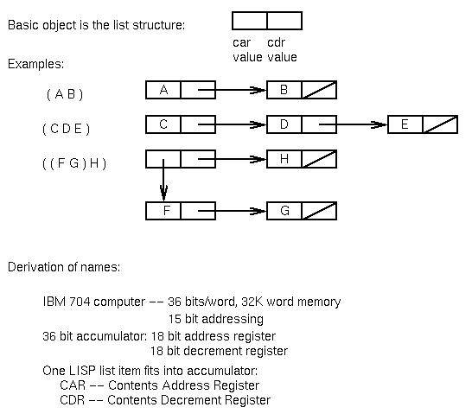
LISP data structures
Developed in 1960 by McCarthy at MIT

Slide 6
Basic LISP operations
Operators:
(car ( 1 2 3 )) = 1 ⇐ head of list
(cdr ( 1 2 3 ) ) = ( 2 3 ) ⇐ tail of list
(cons a ( b c d ) ) = ( a b c d ) ⇐ join operation
(cons ( car ( cdr (a b c))) ( c d)) = (b c d)
But: (cons (a b ) ( c d ) ) = ( ( a b ) c d )
(+ 1 2) = 3 ⇐ [also - * /]
Conditional:
(cond (predicate1) (predicate2) … (T expression))
⇐ Evaluate each predicate and and stop when
first predicate becomes true (T)
Example if-then-else:
(cond ((eq A 2)(print “true”)) (T (print “false”))
Define functions: applicative like in ML:
(defun x) (expression)

Slide 7
Some simple functions
atom - true if argument is an atom (not a list)
null - true if list is empty
numberp - true if argument is a number
append - appends two lists
eq - true if both arguments point to the same object
equal - true if both arguments have the same list members
quote - (quote X) = X [Also written as (‘X)]
[See next slide]
and, or, not - Logical operations
read - read from keyboard
print - write to keyboard
bye - exit LISP environment

Slide 8
LISP storage
LISP is first language that makes heavy use of heap storage.
Storage reclaimed automatically by LISP environment when out of space.
Uses space efficiently. Each LISP item is a fixed size object allocated in the heap.
As example shows, although based on a heap, LLISP still needs a stack for execution.
Example: Trace execution of:
(defun f1(x y z) (cons x (f2 y z ) ) )
(defun f2(v w) (cons v w) )

Slide 9
